Slide 1
校園故事
(Animaze)

Slide 2

Notes:
https://www.stockvault.net/photo/293643/oracle-girl-photoshop-photo-montage-artwork

Slide 3
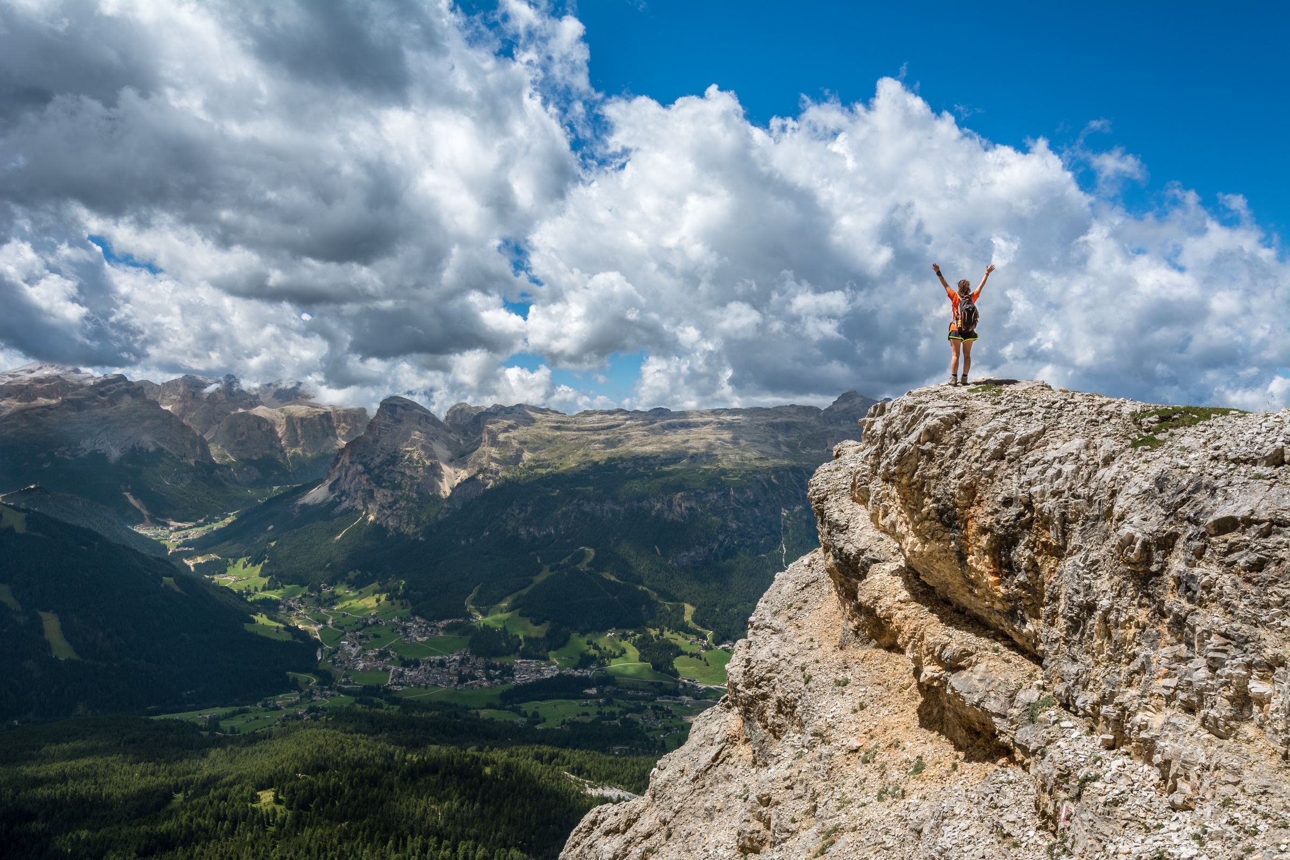
1.目標
Notes:
https://www.stockvault.net/photo/187054/hiker-on-the-top

Slide 4
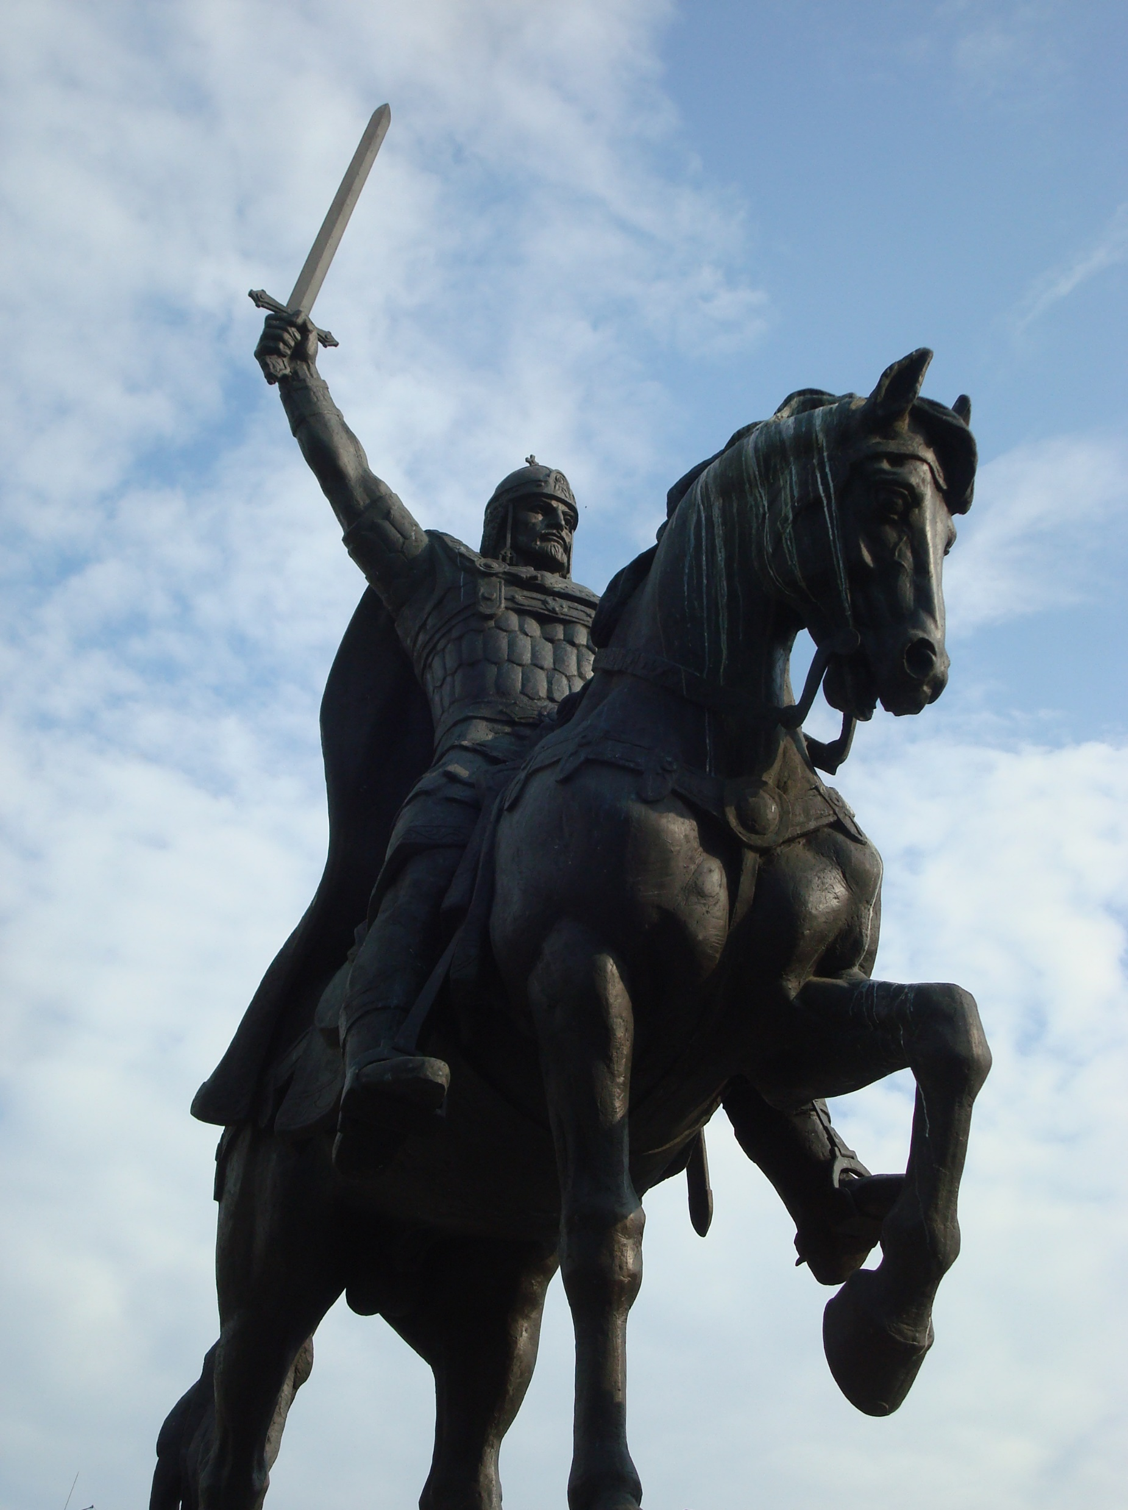
Notes:
https://www.stockvault.net/photo/145086/king-kaloyan-monument-bulgaria

Slide 5
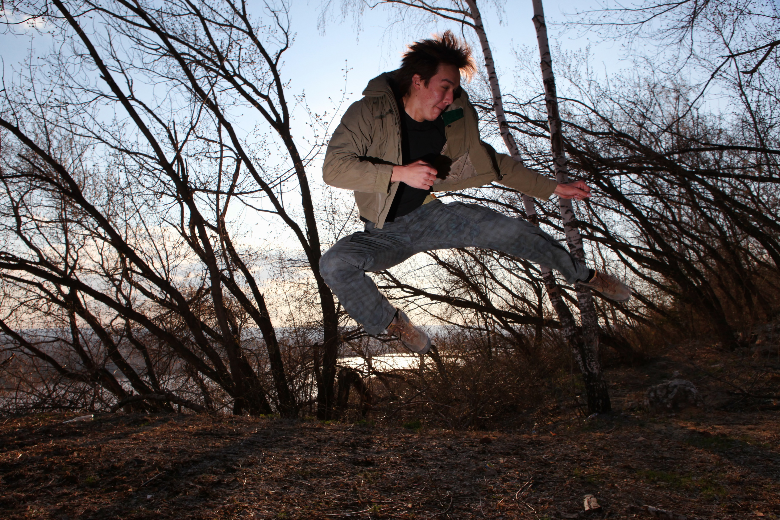
2.阻礙
Notes:
https://www.stockvault.net/photo/121344/man-jumping

Slide 6
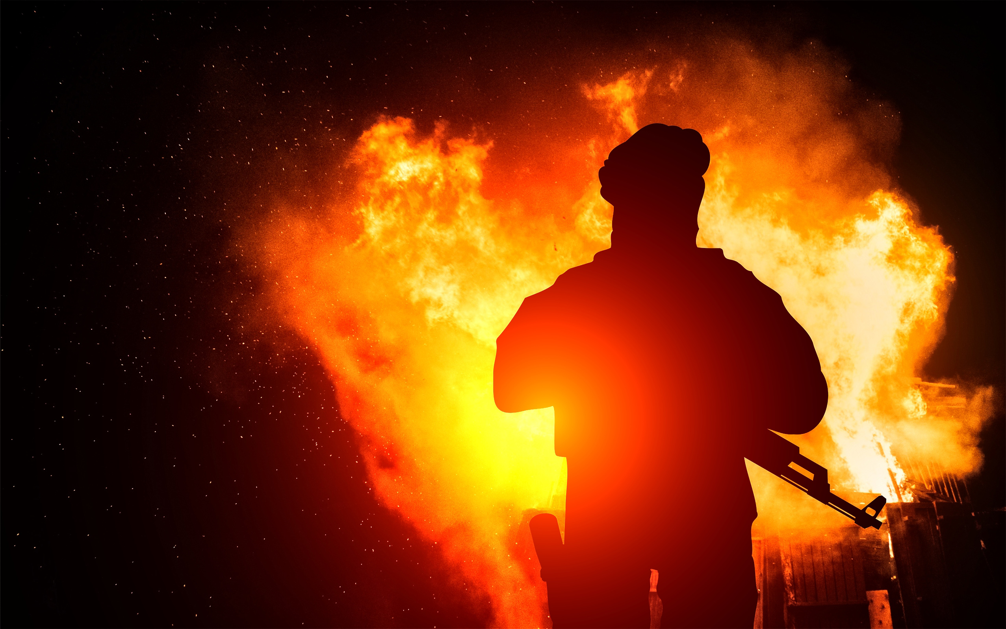
Notes:
https://www.stockvault.net/photo/182762/armed-man-with-background-explosion

Slide 7
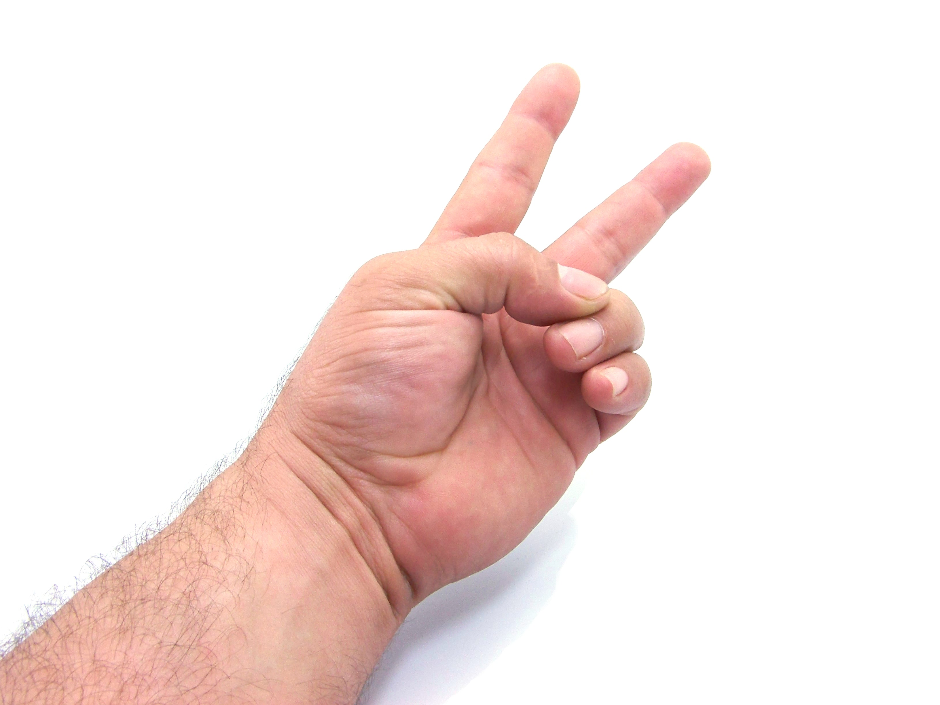
Notes:
https://www.stockvault.net/photo/108313/two-fingers

Slide 8
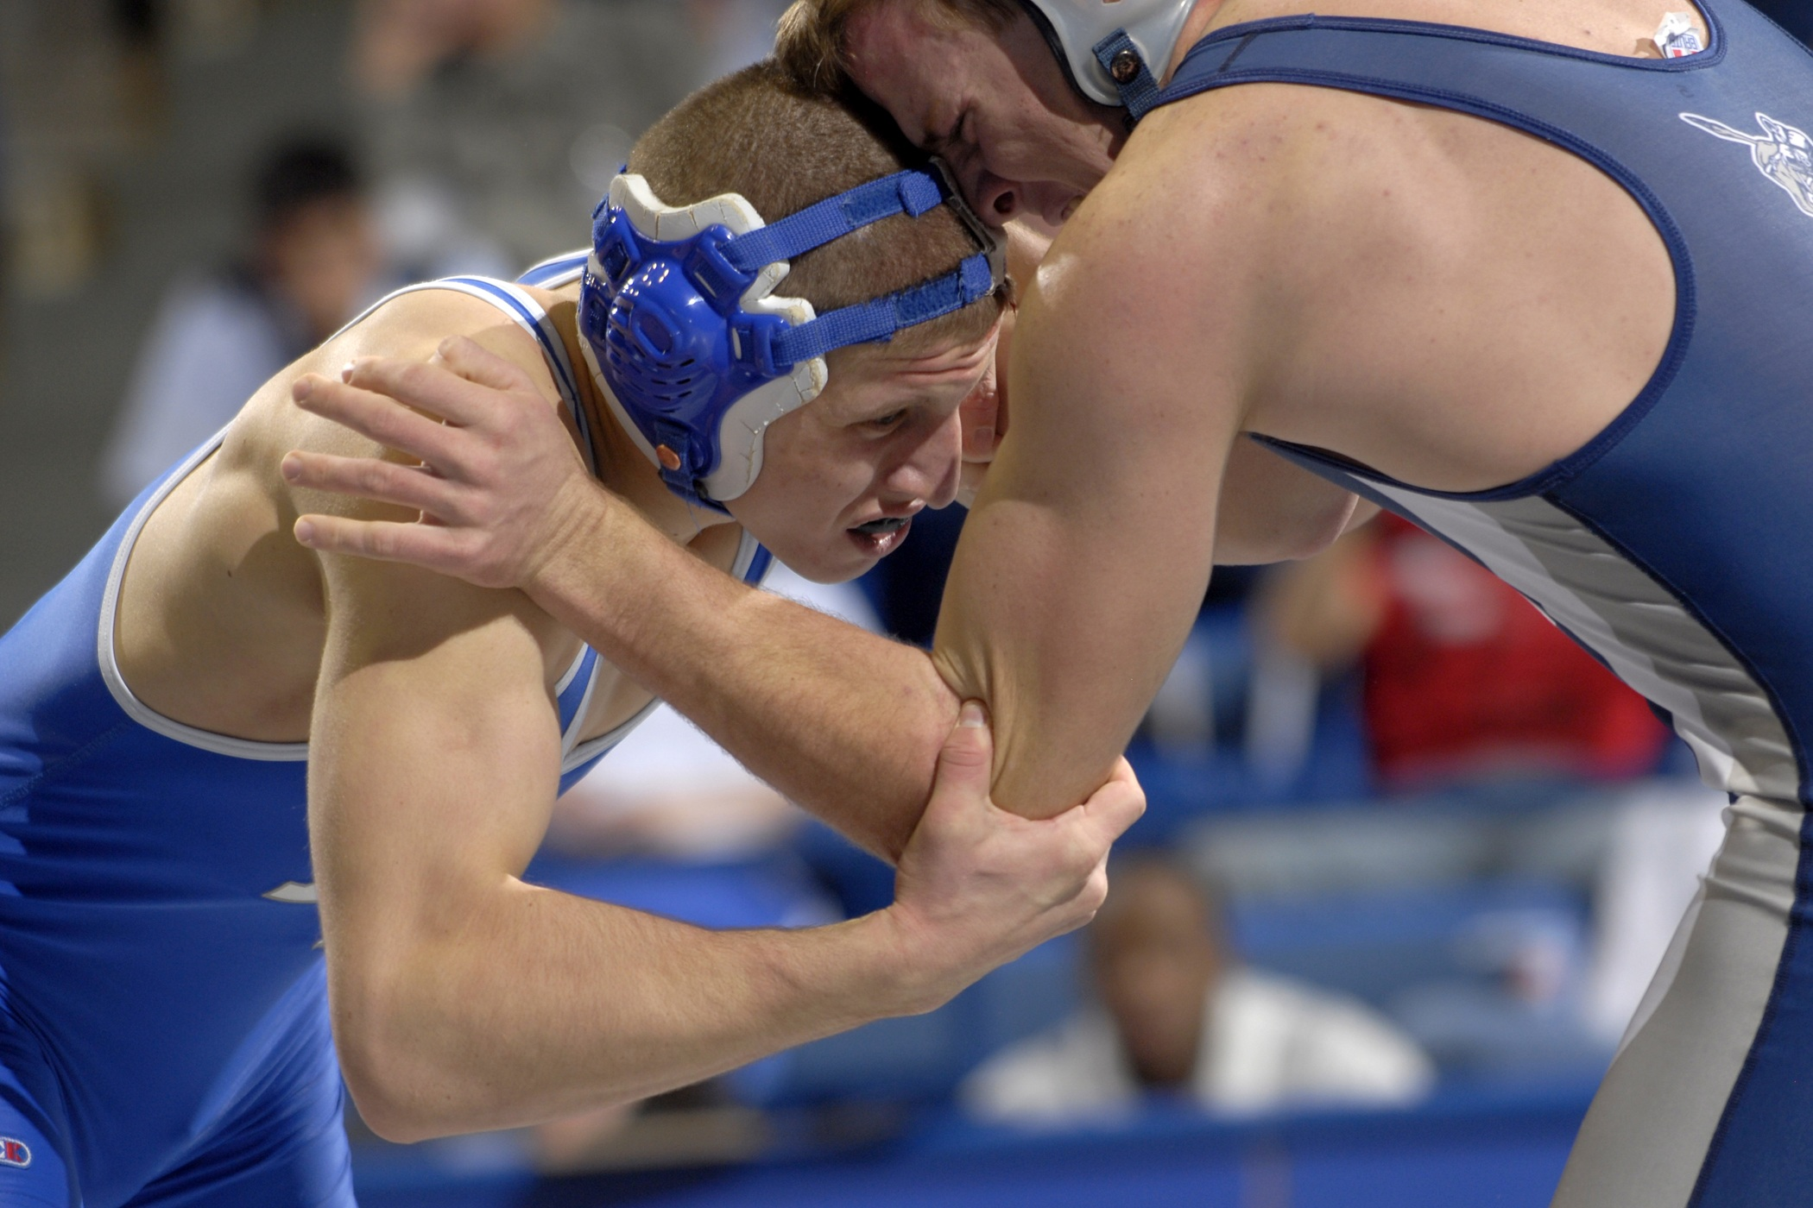
3.努力
Notes:
https://www.stockvault.net/photo/203527/wrestling-ring

Slide 9

Notes:
https://www.stockvault.net/photo/240216/vibrant-ice-cracks

Slide 10
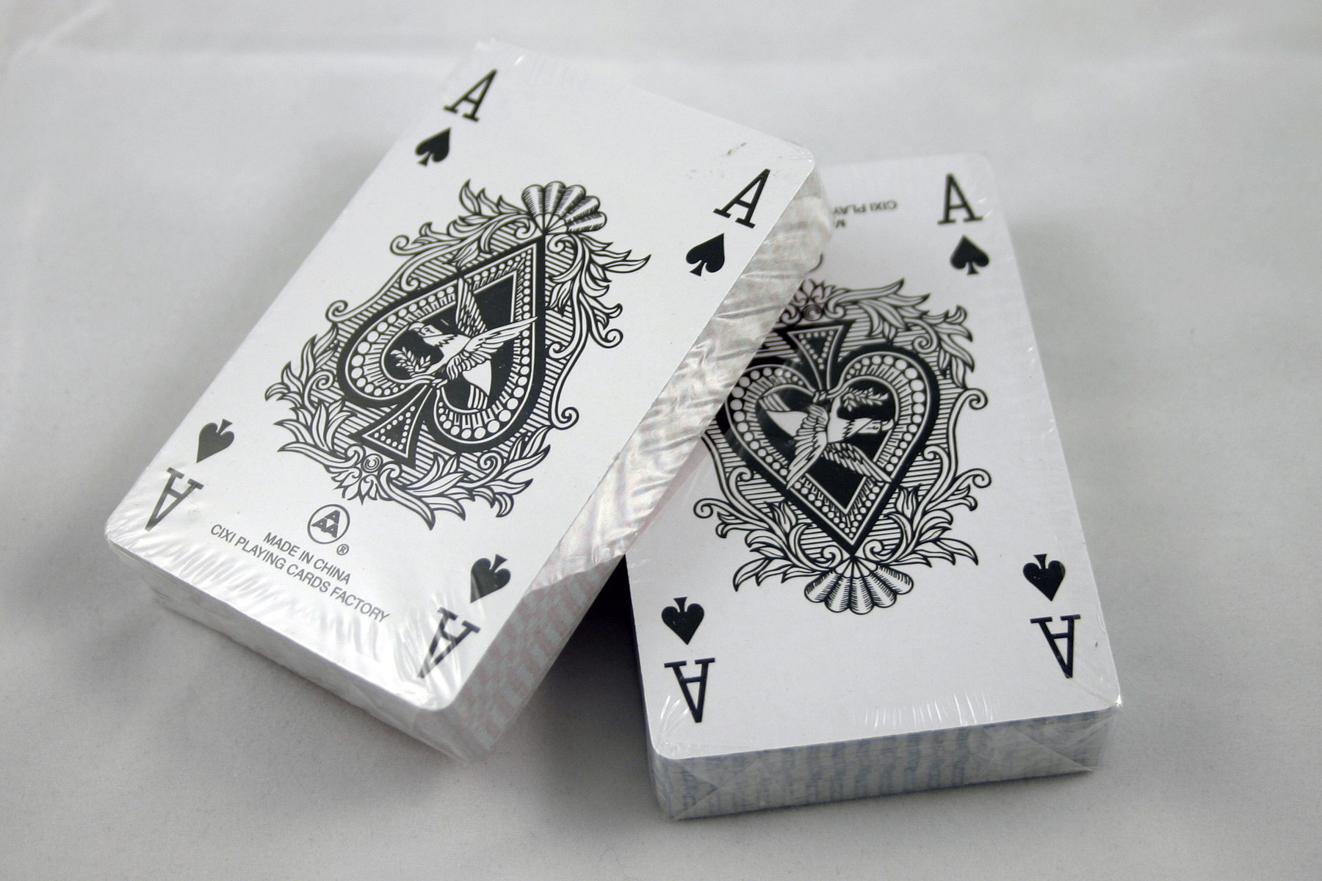
Notes:
https://www.stockvault.net/photo/98272/deck-of-cards

Slide 11
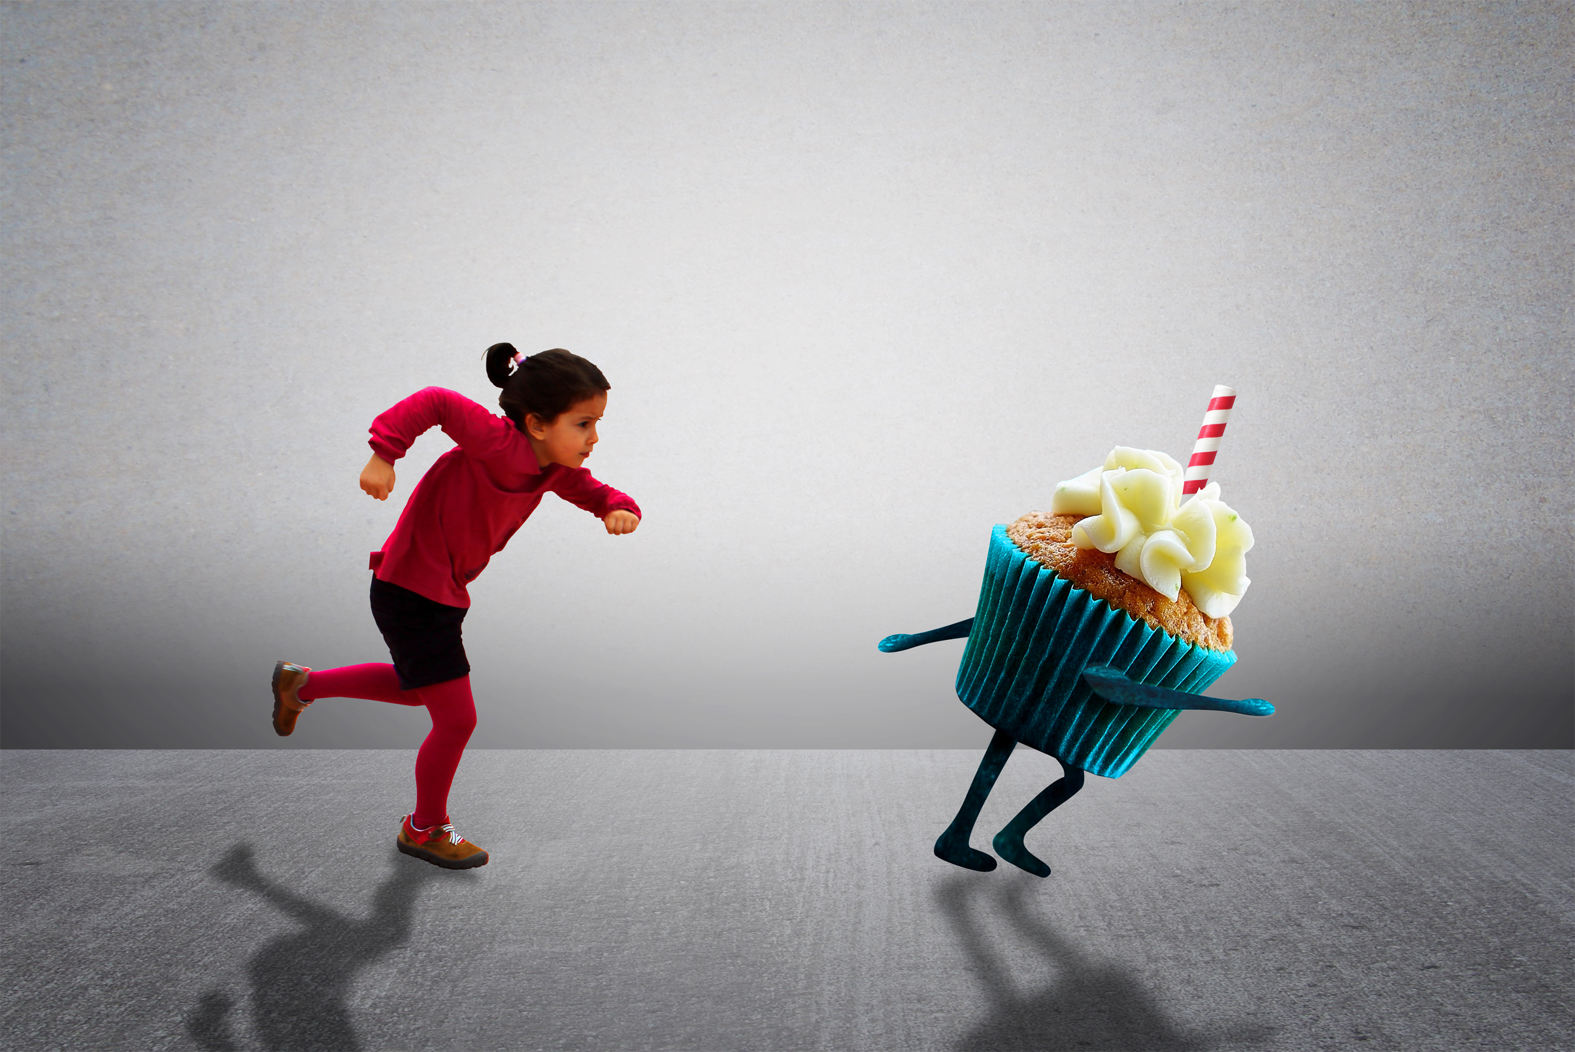
4.結果
Notes:
https://www.stockvault.net/photo/196833/child-chasing-cupcake-healthy-diet-versus-child-obesity

Slide 12

Notes:
https://www.stockvault.net/photo/263253/woman-accepting-award

Slide 13

Notes:
https://www.stockvault.net/photo/118816/fire

Slide 14

5.意外
Notes:
https://www.stockvault.net/photo/226372/get-up-clock-message-meaning-wake-up-and-rise

Slide 15
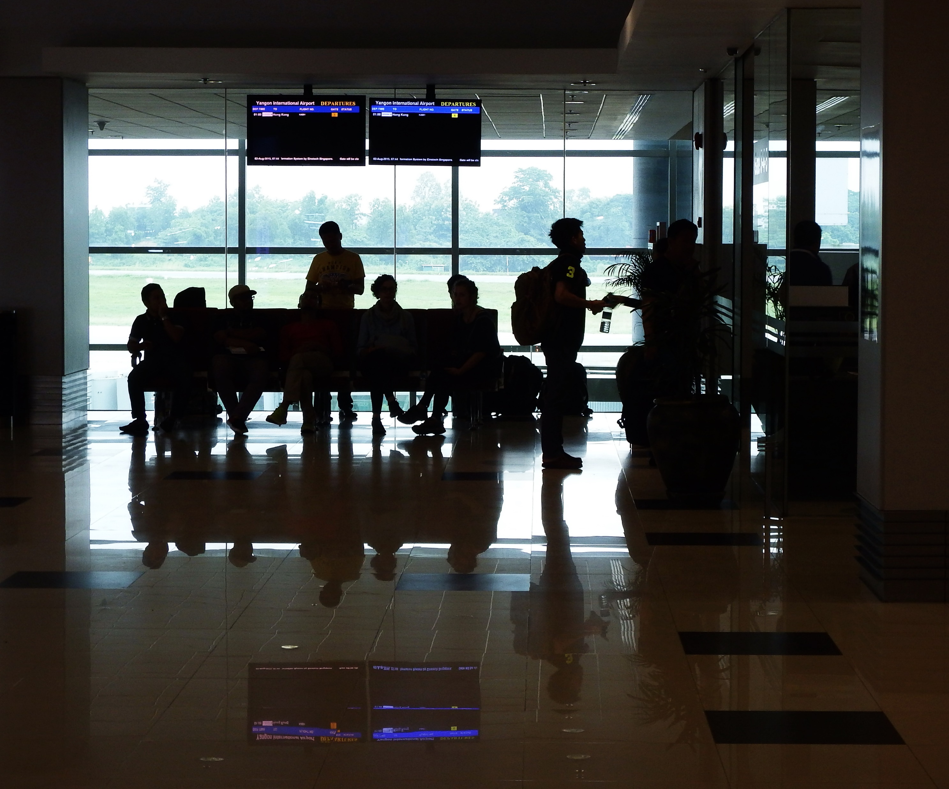
Notes:
https://www.stockvault.net/photo/176916/passenger-silhouettes-at-airport

Slide 16
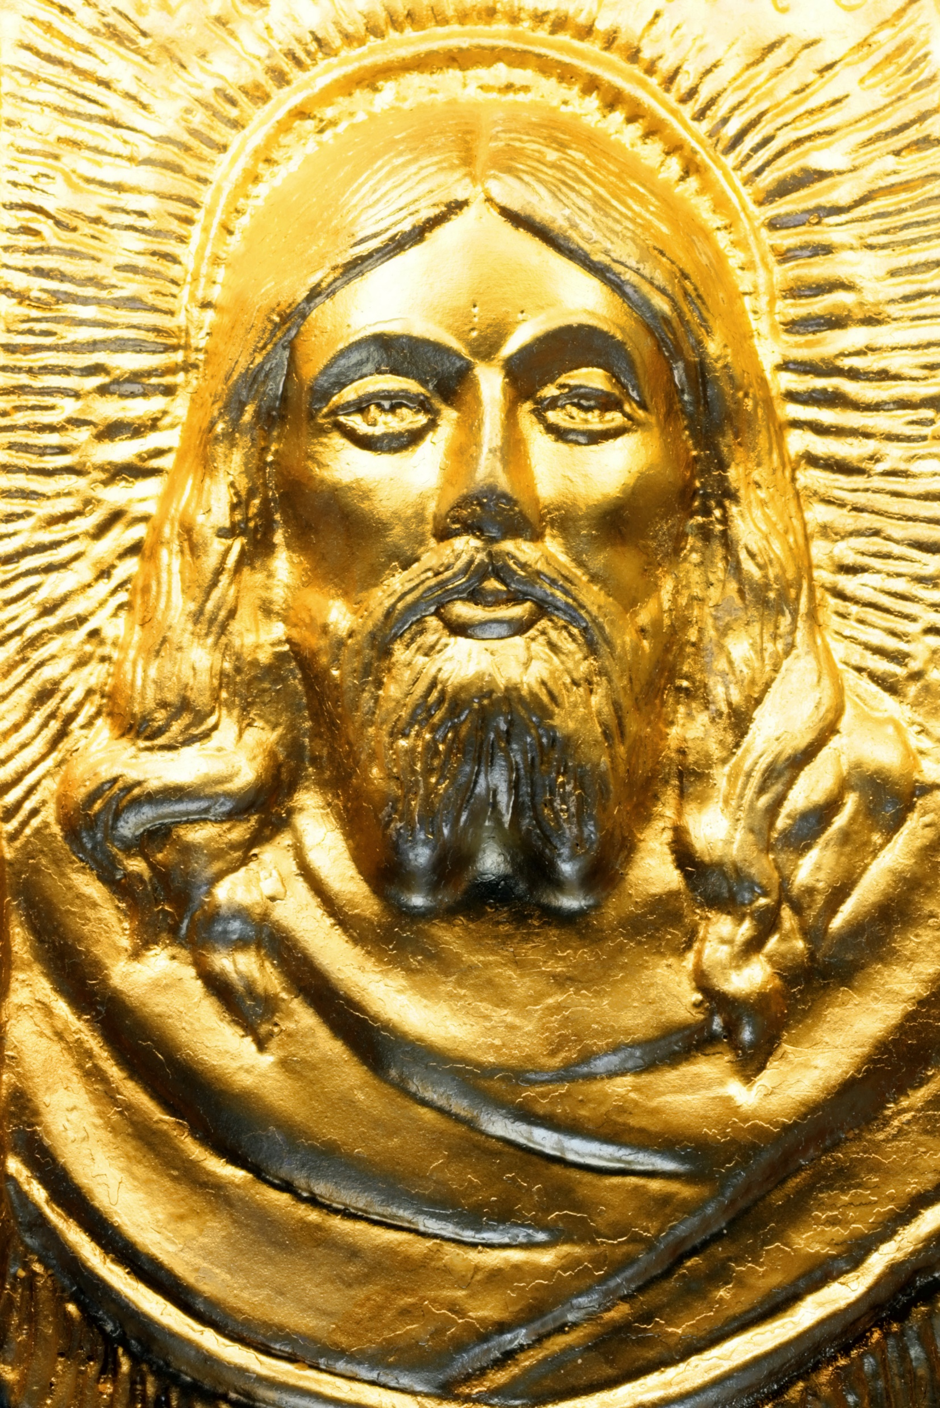
6.轉彎
Notes:
https://www.stockvault.net/photo/121449/jesus

Slide 17

Notes:
https://www.stockvault.net/photo/253404/depressed-woman-illustration

Slide 18
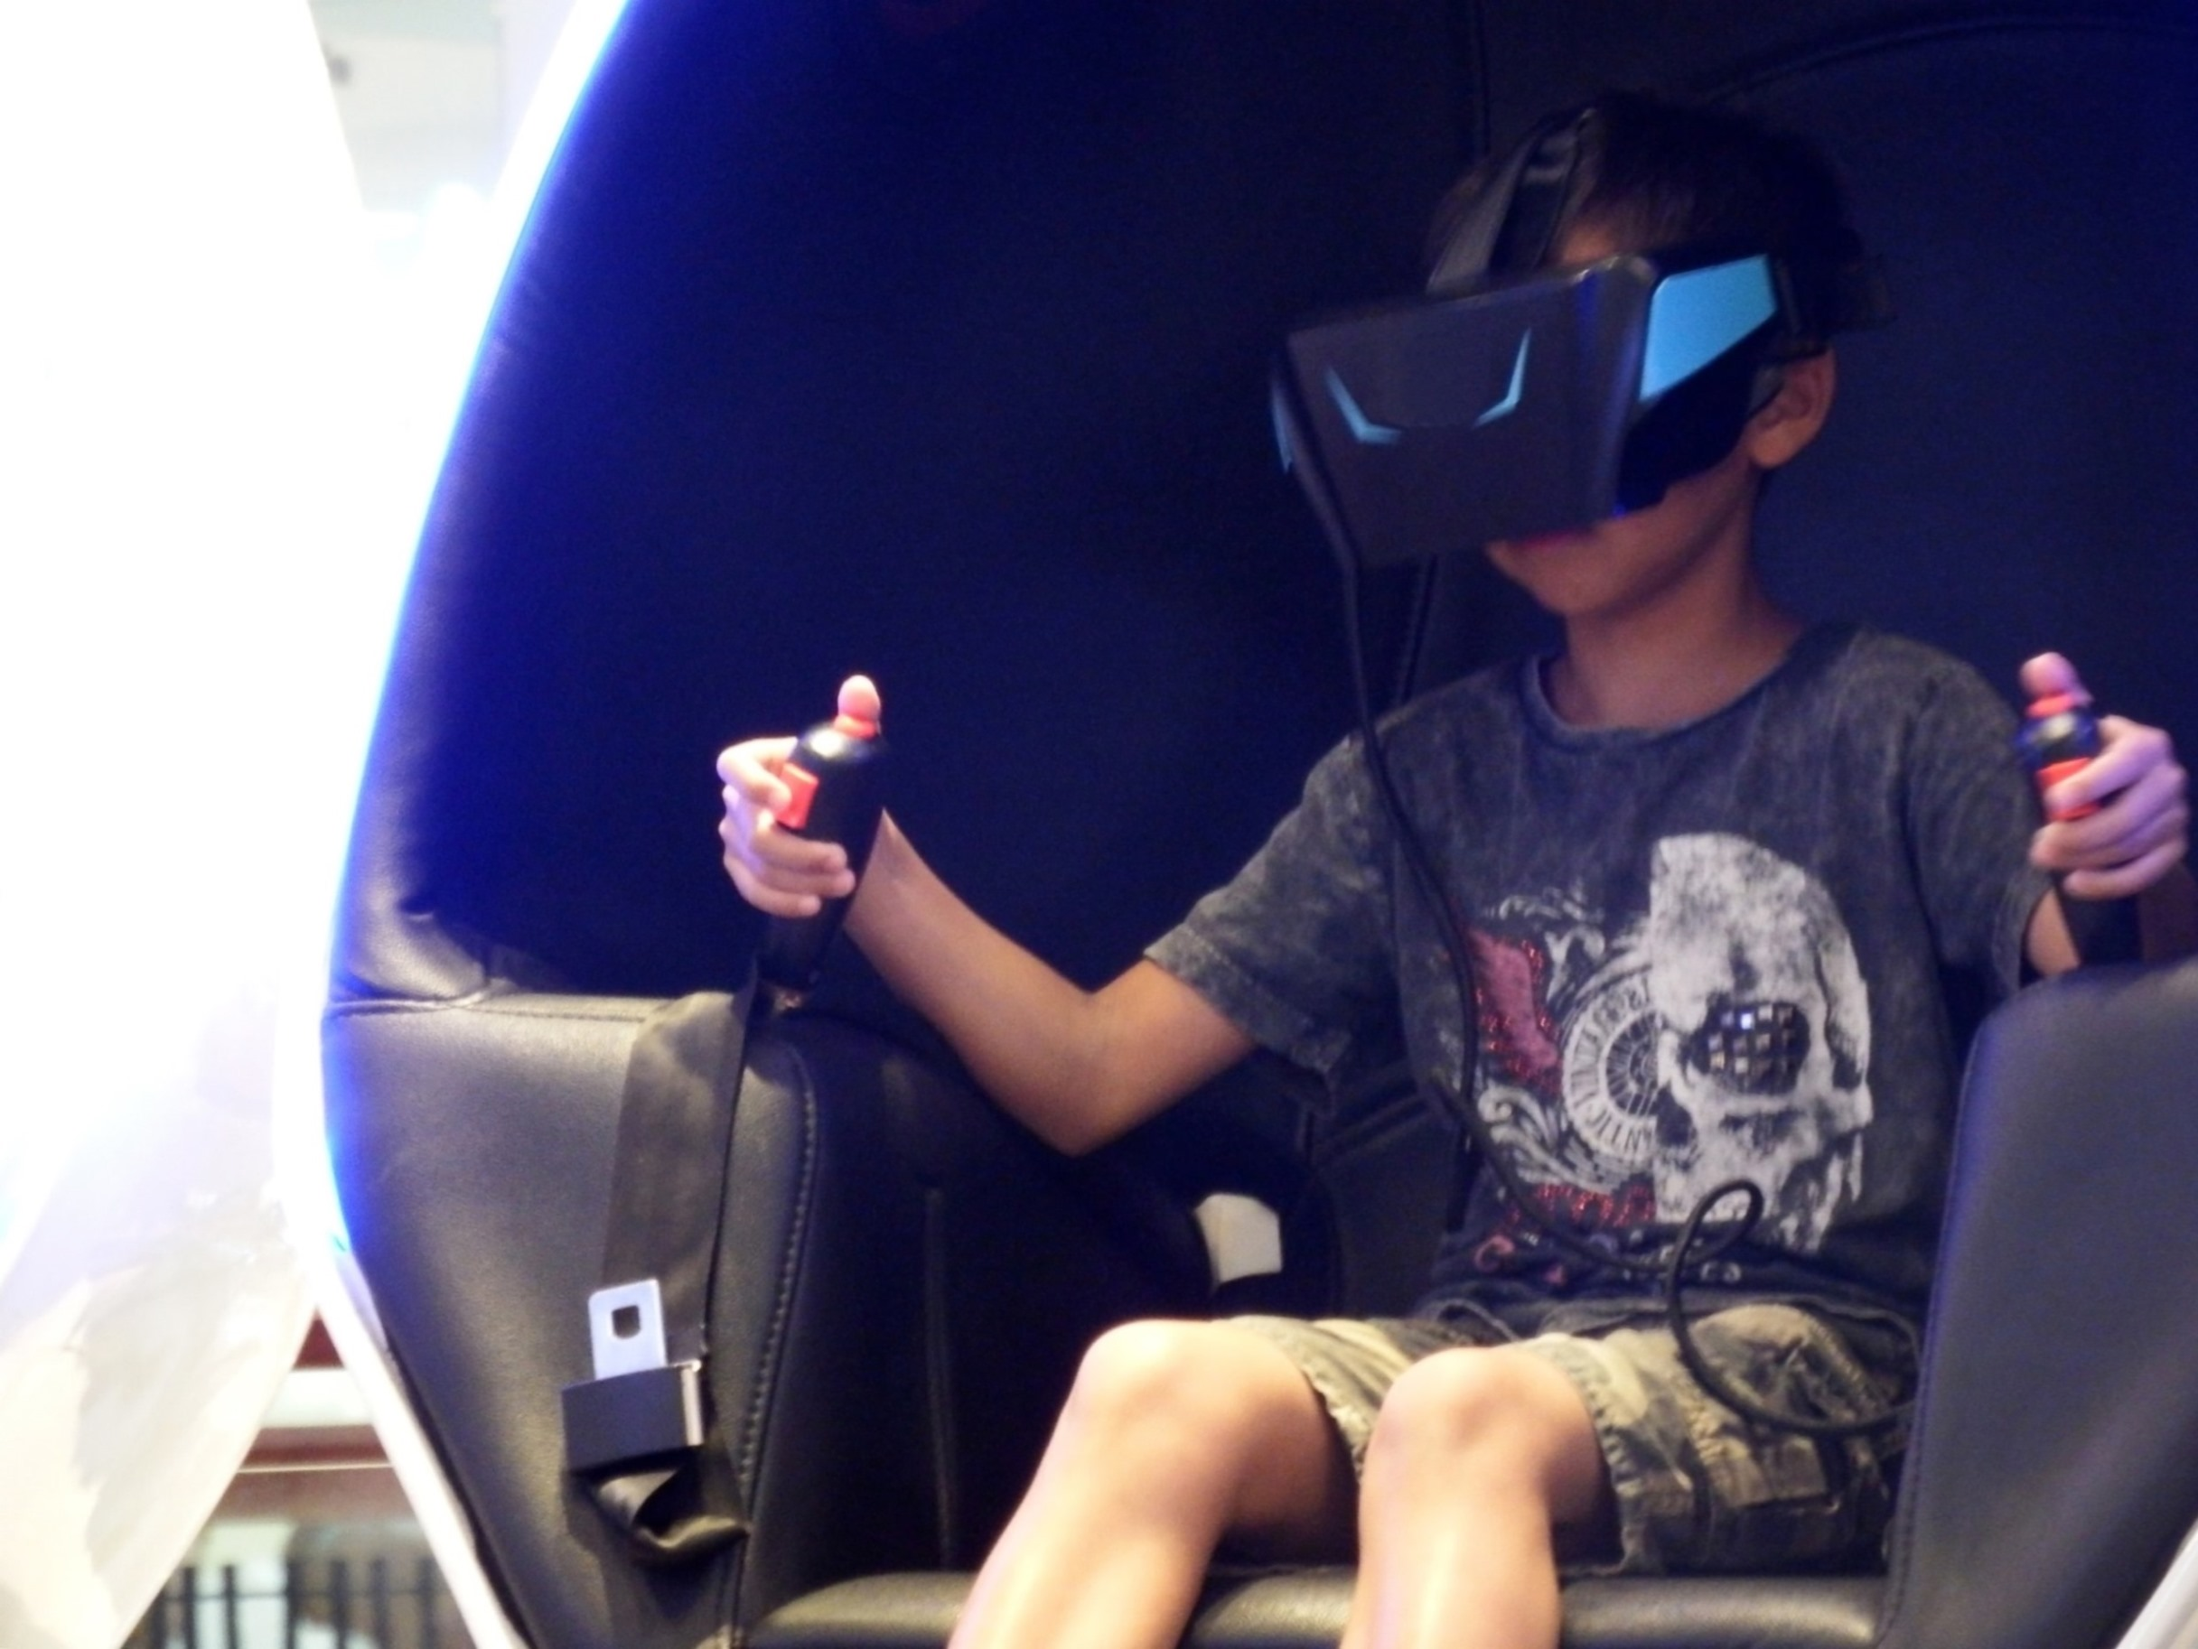
7.結局
Notes:
https://www.stockvault.net/photo/180402/businessman-holding-a-ball-with-information-technology-icons

Slide 19
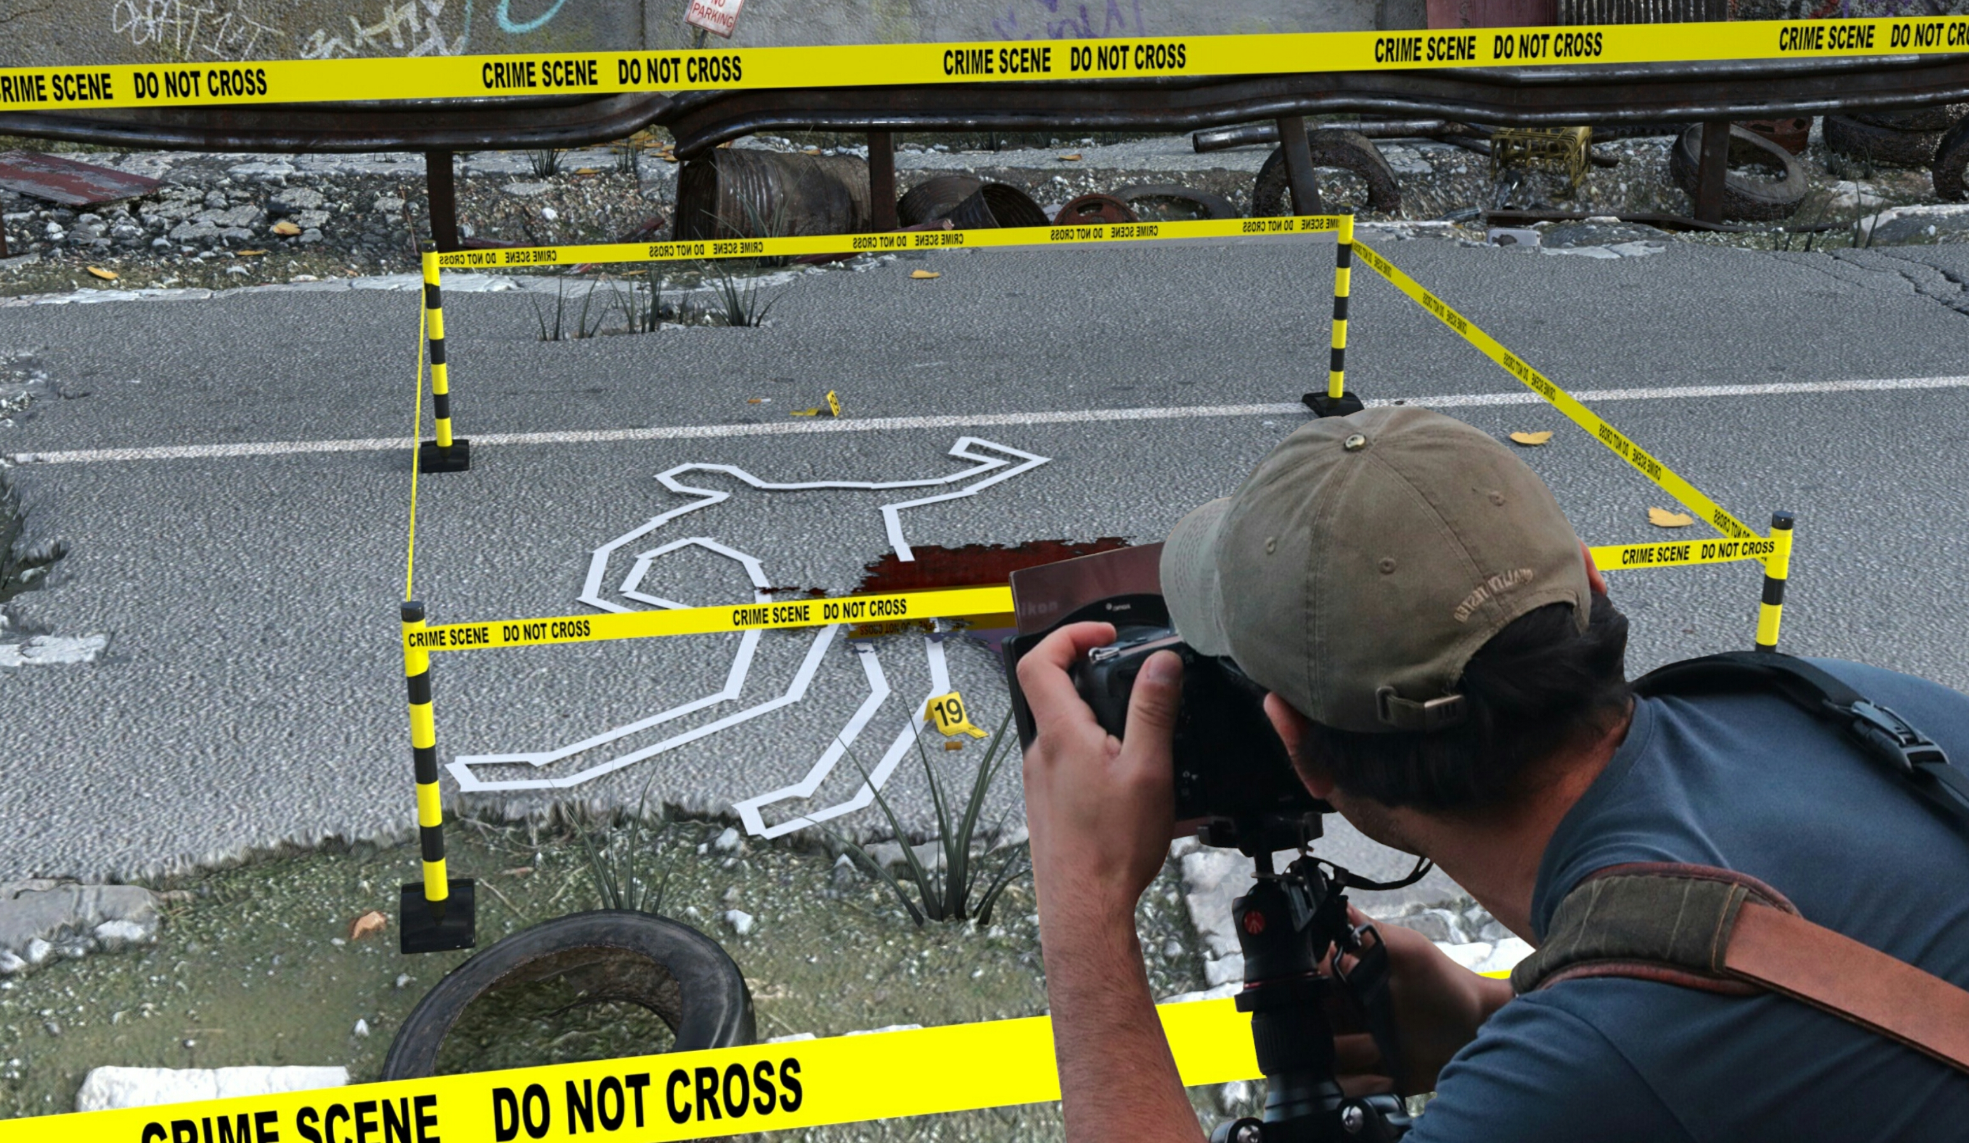
Notes:
https://www.stockvault.net/photo/258767/crime-scene-photographer

Slide 20
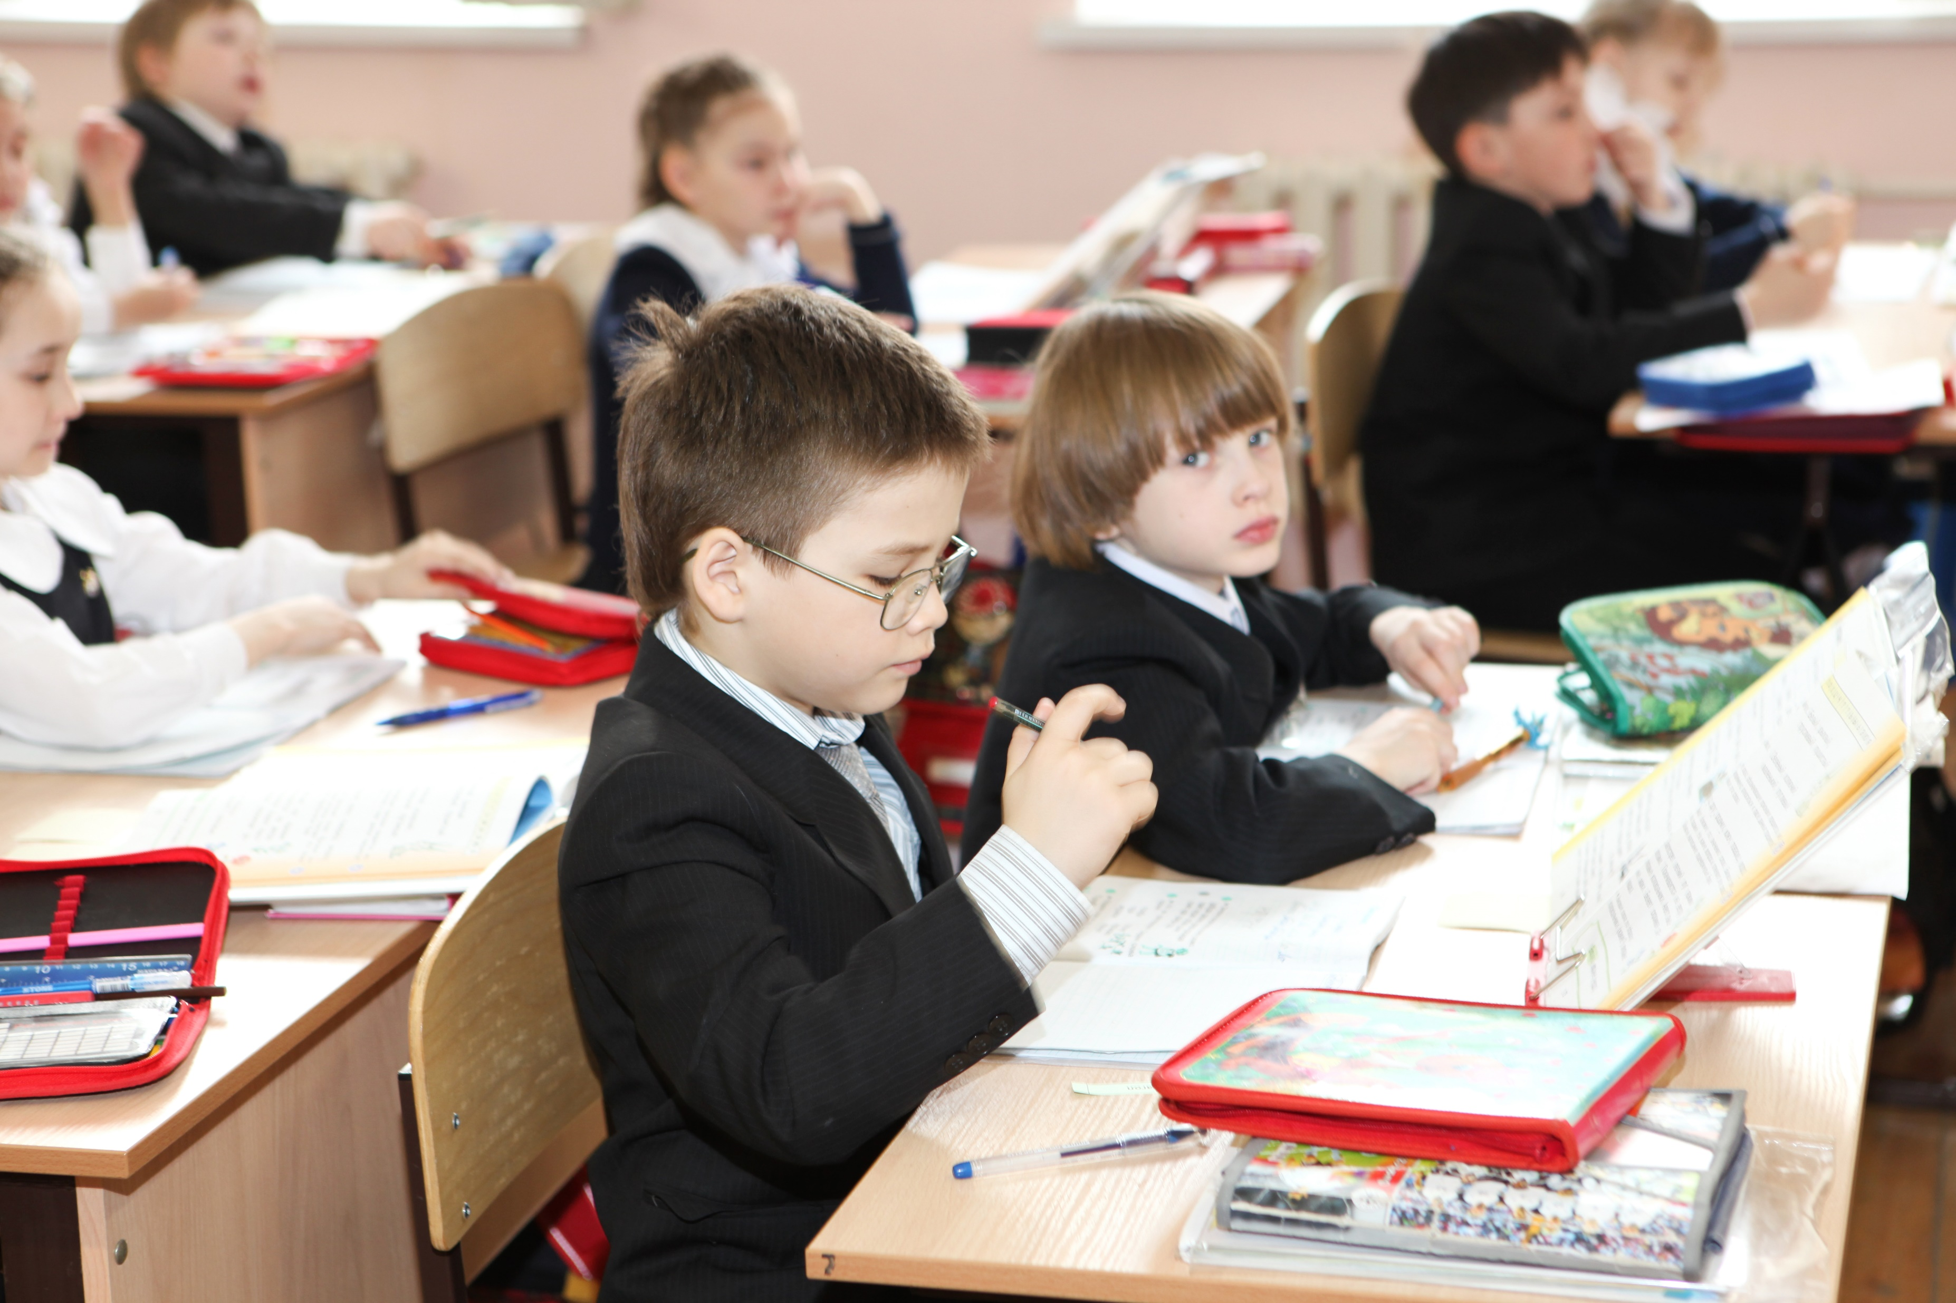
Notes:
https://www.stockvault.net/photo/129765/school-boy

